Slide 1
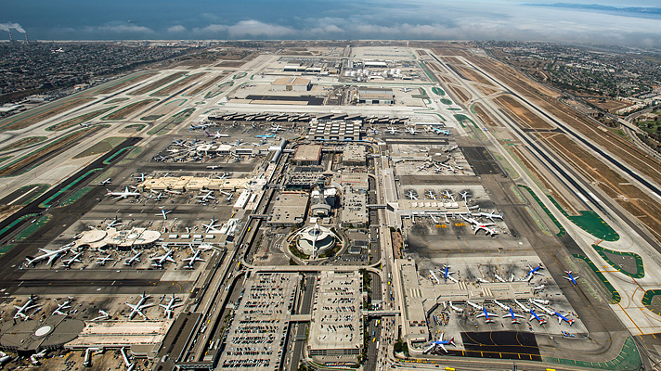

Facility-Based
Facility-Based Mobile Source Control Measures
Commercial Airports
FBMSM
5th Working Group Meeting
February 1, 2018

Slide 2
Agenda
Background
General conformity related to airport projects
Overview of MOU Process
Key principles of airport MOUs
Elements within airport MOUs
Next Steps

Slide 3
General Conformity Process
Requirements
De Minimis Threshold
Conformity Determination
40 CFR 51.851 and 93.150-165
SCAQMD Rule 1901
Threshold for NOx or VOC > 10 TPY and
PM2.5 > 70 TPY
No projects have exceeded PM2.5 threshold*
Projects below threshold do not require accounting against the SIP inventory
Projects above de minimis threshold must demonstrate the project’s emissions are accounted for in the SIP
2016 AQMP contains conformity budget and a set aside account for projects that exceed de-minimis threshold
* NOx (commonly) and VOC (rarely) exceed thresholds during construction of large projects

Slide 4
General Conformity ─ Budget
Projects can be included explicitly in AQMP or in subsequent actions
  LAX LAMP project and JWA general aviation program included in 2016 AQMP
SCAQMD tracks emissions subject to federal conformity and compares it against set-aside account
Discussion point:
  Potential for considering future airport emission reductions with General Conformity and SIP credit
Budgeted Projects

Slide 5
Initial Key Principles of MOU Process
  Emissions reductions beyond 2023/2031 baseline reflecting existing regulations
  Maintain ability to get incentive funding
  Public process/input in development and implementation
  of MOU
  Metrics to determine effectiveness of MOU
  Mechanism for enforceability
  MOU should not conflict with existing federal/state/local laws
  Measures within MOU must be feasible
  Timing must address AQMP needs
  MOU should contain SIP creditable emission reductions

Slide 6

Overview of Potential* MOU Process & Timeline
Development of
SCAQMD/Airport MOU
Airport Develops AirCAAP
Airport Approves AirCAAP
All Necessary Approvals
Public Process
CEQA
Incentives
Inventory
Measures
Airport Clean Air
Action Plans
Airport Begins Process
by June 1, 2018
Airport Approves AirCAAP
By January 1, 2020
SCAQMD/Airport Approve MOU By July 1, 2020
*Process could include SCAQMD rule requiring development of AirCAAPs by commercial airports

Slide 7
Emission Sources Included in AirCAAP
On-Road Vehicles
Passenger traffic
Airport/Airline-controlled vehicles
Off-Road Vehicles
Ground Support Equipment
Construction Equipment
Aircraft
Only included if airport volunteers aircraft measures in AirCAAP
Cargo traffic

Slide 8
Critical Elements within MOU
Requirements for Airports
Requirements for District
Enforceable Mechanism
Regular reporting of effectiveness of MOU
Implementation Elements
Recordkeeping and tracking components (e.g. VMT, fuel usage, etc.)
Process to remedy potential non-compliance
Recordkeeping and reporting
Commitment to implement the AirCAAP
Process to address unforeseen shortfalls
Methodologies for calculating emissions and emissions reductions
Opportunities for public involvement

Slide 9
SIP Credit Process
SIP Credit*
MOU
SCAQMD Commitment
Quantified Emission Reductions
SIP Integrity Elements
*Subject to EPA Approval

Slide 10
Next Steps
Report to Mobile Source Committee on February 16, 2018
Present Emission reduction strategies to the Governing Board on March 2, 2018 and seek further direction

Slide 11
Staff Contacts
Ian MacMillan
Planning and Rules Manager
(909) 396-3244
imacmillan@aqmd.gov
Dan Garcia
Program Supervisor
(909) 396-3304
dgarcia@aqmd.gov

Slide 12
Questions or Comments?

