Slide 1
Proposed Amended Rule 2202
On-Road Motor Vehicle
Mitigation Options
Working Group Meeting #2
March 22, 2023
Join Zoom Webinar Meeting
https://scaqmd.zoom.us/j/94339030649
Webinar ID: 943 3903 0649
Teleconference Dial-In: (669) 900-6833

Slide 2
Agenda
Recap of Working Group #1
Current implementation of Rule 2202
Proposed concepts for potential amendment to Rule 2202
Rule cleanup and administrative revisions
Telecommuting
Vehicle Miles Travelled (VMT) reporting
Next steps

Slide 3
Working Group
#1 Recap

Slide 4
Working Group #1 Recap
Reviewed Rule 2202 background and history
Discussed purpose for Proposed Amended Rule 2202
Phase 1 – August 2023
Phase 2 – 2025-2026
Introduced VMT and associated data collection
Addressed attendee questions about PAR 2202, compliance, etc.

Slide 5
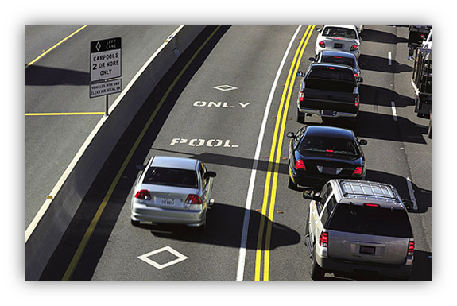
Working Group #1 Recap (cont.)
Themes of Questions and Comments
Vehicle Miles Travelled (VMT)
Example: How will worksites report VMT for employees?
Telecommuting
Example: Are teleworkers included in AVR survey?
Rule cleanup and administrative revisions
Example: Can I conduct my AVR survey during the fourth week of June?
Compliance with current Rule 2202
Guidance documents and compliance forms available on website: http://www.aqmd.gov/home/programs/business/business-detail?title=rule-2202-on-road-motor-vehicle-mitigation-options
Contact South Coast AQMD staff

Slide 6
Current Rule 2202 Implementation

Slide 7
Current Rule 2202 Implementation: COVID-19 Temporary Protocols
South Coast AQMD provided employers with temporary flexibility due to the pandemic:
Protocols that will remain in effect
Human resources / Payroll records to document telecommuters*
Records to document telecommuters in place of employee survey
Pandemic- aided employers who employed remote working practices (increased response rates)
Post-Pandemic- ease reporting of telecommuters; continue to incentivize teleworking policies
Temporarily furloughed employees**
Exempt from total worksite employee count
Pandemic- uncertain on return of furloughed employees
Post-Pandemic- worksite employment levels beginning to stabilize
* Per Rule 2202 (g)(1)(d)
** Per Rule 2202 (d)(7)

Slide 8
COVID-19 Temporary Protocols (cont.)
Protocols to be removed July 1
No Cost Extensions
Fees for extension of annual report submissions will be reinstated
Waived Late Fees
Late plan submittal fees will be reinstated
Worksite Inspections
Worksite inspections to resume as needed

Slide 9
PAR 2202
Rule Cleanup and Administrative Changes

Slide 10
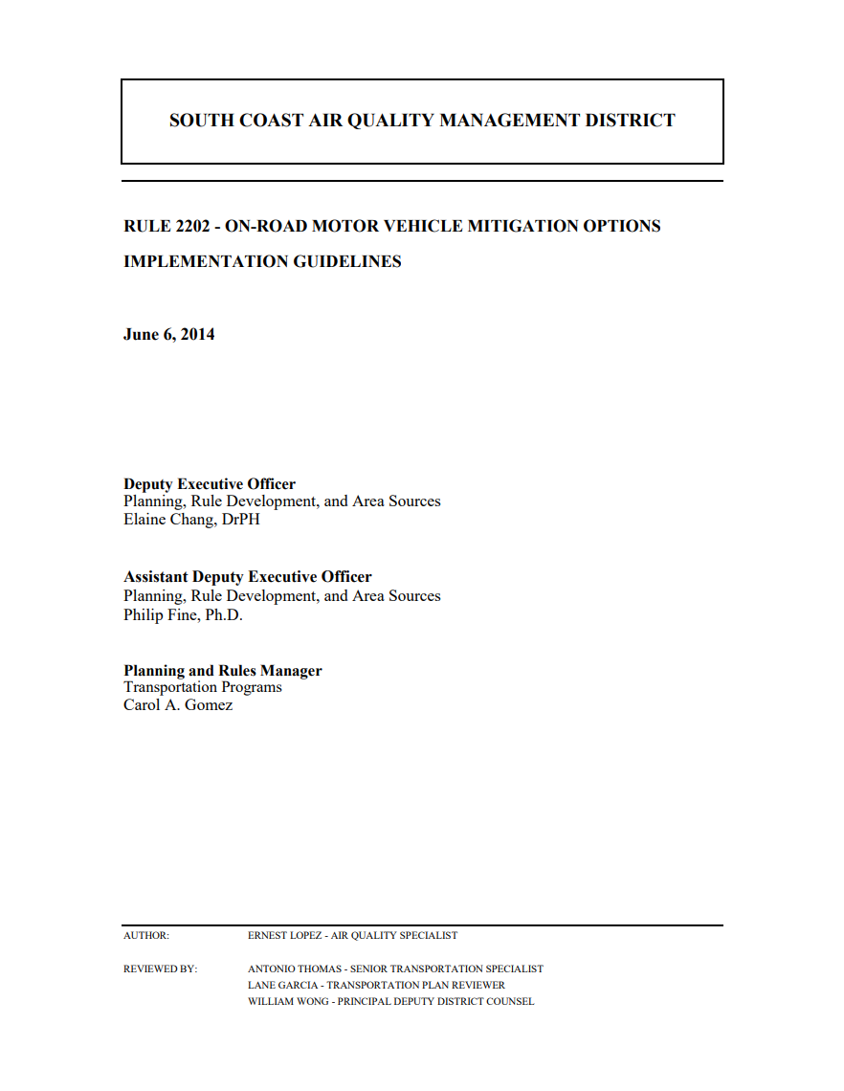
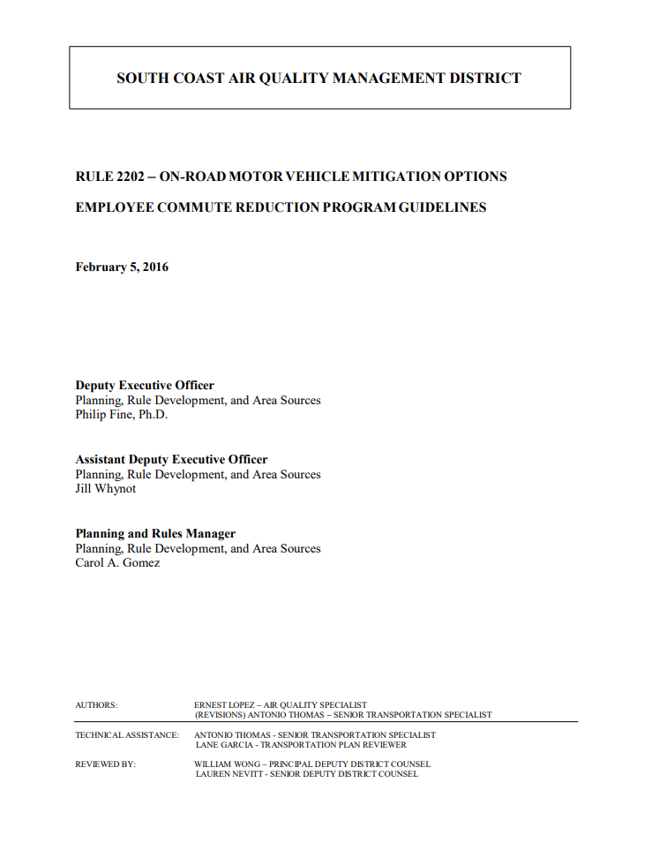
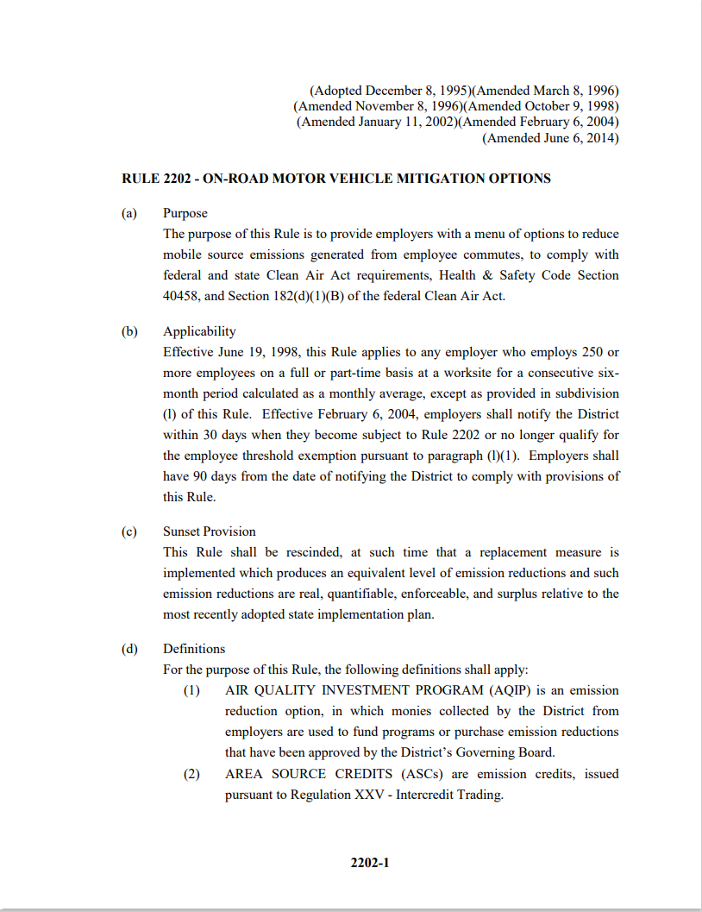
Proposed Amended Rule (PAR) 2202:
Rule Cleanup & Administrative Changes
Implementation and ECRP Guidelines
Purpose of documents is to provide guidelines for compliance with the provisions of Rule 2202
Plan review period increase from 90 days to 120 days*
Provide staff additional review time
Revise holiday definition in rule and guideline language to reflect state and national holidays**
Will consider new holidays as they become recognized
This will include newly recognized Juneteenth (June 19)
*Per Rule 2202 Implementation Guidelines (G)(4); per ECRP Guidelines (II)(A)(c,d,f) and (IV)(B, G-H)
** Per Rule 2202 (e); per Rule 2202 Implementation Guidelines(VI)(13); per Rule 2202 ECRP Guidelines (VI)(20)
910

Slide 11
PAR 2202:
Rule Cleanup & Administrative Changes (cont.)
Employee Transportation Coordinator (ETC) Training
Currently conduct two ETC training classes per month
Conducted virtually
One-time certification
Potentially may require Employee Transportation Coordinator (ETC) training for all sites submitting AVR surveys
Helps to eliminate transportation plan submittal errors
Will address comprehension of rule requirements and high ETC turn-over rate
Facilitate awareness of VMT data collection and other potential future compliance modifications
Will include a temporary flex period for sites with annual due dates near rule amendment date
11

Slide 12
Proposed Amended Rule:
Rule Cleanup & Administrative Changes (cont.)
Add/modify rule definitions and terms for:
Furloughed employee
Telecommuting
VMT
ZEV & other vehicles (ex. Hydrogen-FCEV)
Clarify rule language around ECRP compliance option in On-Road Motor Vehicle Mitigation Options
ECRP is listed as “other” compliance option, is not clearly defined, itemized under exemptions (ECRP Guidelines (f)(6),(l)(3)
Minor administrative language revisions for clarification (e.g. acceptance of digital signatures)
Update ECRP strategies to include additional information / clarification (Implementation Guidelines (F)(1)(a-g), (2)(a-h), (3)(a-r)
EV infrastructure
Mobility hub services
Electric scooters/bicycles
Remove fuel component in Auto Services
12

Slide 13
Telecommuting
in PAR 2202

Slide 14
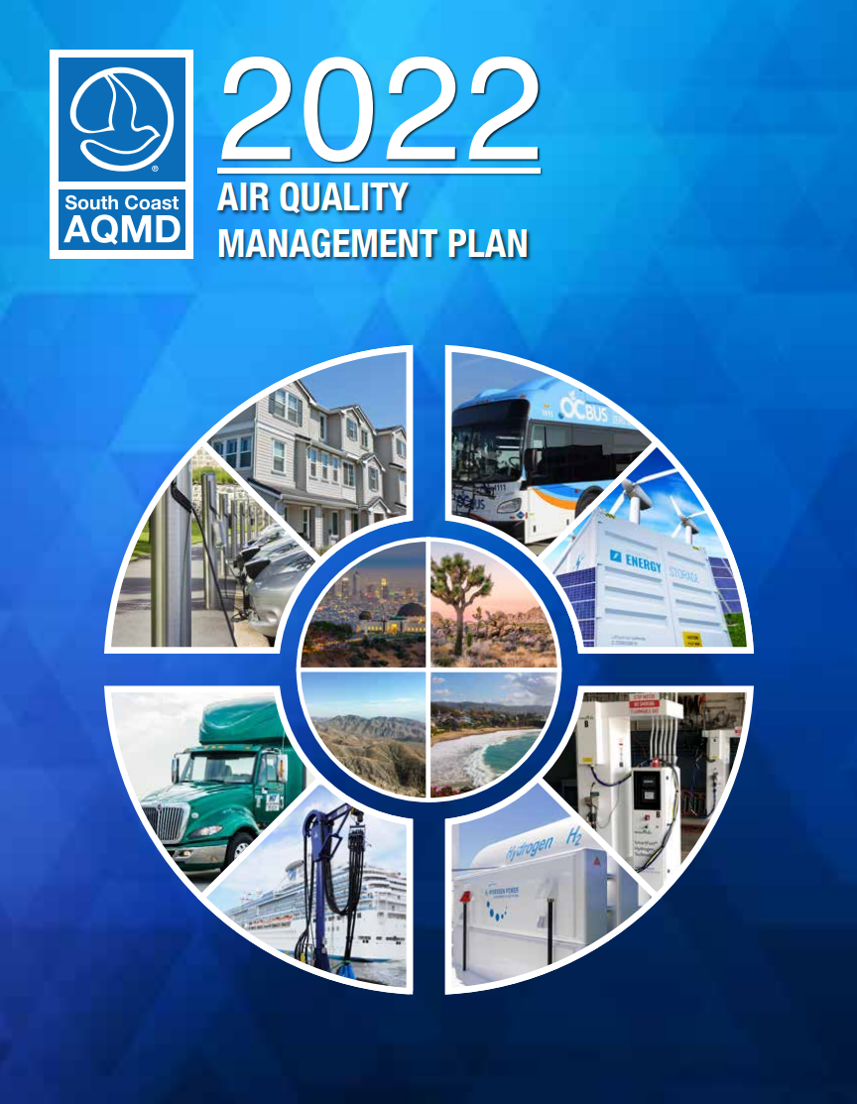
PAR 2202 Concepts: Telecommuting
2022 AQMP Control Measure MOB-14
The 2022 Air Quality Management Plan proposed amending Rule 2202 to further reduce emissions associated with work trips.
During the COVID-19 pandemic, regulated employers incorporated widespread telecommuting practices
Staff recognizes that these telecommuting policies are continuing to evolve
Telecommuting is cited as a key mechanism to achieve additional emission reductions in Rule 2202
14

Slide 15
Telecommuting Data
Average Vehicle Ridership (AVR) mode data shows an increase in the amount of telecommuters starting in 2020 and the corresponding impact on AVR scores.
In 2019, sites that implemented telecommuting reported an average of 19.7 telecommute trips/day
In 2020, average telecommute trips/day rose to 185.1, an increase of over 9x
This reduction of vehicle trips was evident in increased average AVR scores across regulated sites
# of telecommuters
Average Vehicle Ridership
15

Slide 16
Average AVR for ECRP Sites By Zone
Average AVR amongst regulated sites has been greater than
the target AVR for all performance zones since 2020
42.9%*
33.3%*
23.1%*
* The percentage of daily telecommute trips needed to automatically reach AVR if all other trips are in a single occupancy vehicle

Slide 17
Telecommuting Advantages
If a regulated site is capable of implementing telecommuting in their work environment, they will benefit under every plan type. Streamlined reporting and survey requirements will ensure the site benefits from full time telecommuters
Air Quality Investment Program (AQIP)
Emission Reduction Strategies (ERS)
Employer Commute Reduction Program (ECRP)
Reduce the amount of employees reporting to the worksite and pay less in AQIP fees
Reduce the amount of employees reporting to the worksite and purchase fewer emissions credits
Reduce the amount of employees reporting to the worksite which will result in a higher AVR score. Site may qualify for the High AVR or AVR Improvement program
17

Slide 18
Vehicle Miles Travelled Considerations for
PAR 2202

Slide 19
Background:
VMT Considerations for PAR 2202
In 2015, the U.S. EPA tightened the ozone standard. The South Coast Air Basin is in “extreme” nonattainment for ozone.
NOx is the primary pollutant that must be controlled to reduce ozone
Processes that burn fuel result in NOx emissions
Passenger vehicles are one of the top ten emitters of NOx
19

Slide 20
NOx Attainment and On-Road Sources
Approximately 85% of daily NOx emissions come from mobile sources
Additional emission reductions are needed in order to meet the 2037 ozone standard set by the E.P.A., specifically for mobile sources
Emission reductions are also needed to meet earlier ozone standards in 2023 and 2031
Higher Vehicle Miles Travelled (VMT) results in higher emissions
60 tons/day 2037 ozone standard
business-as-usual
20

Slide 21
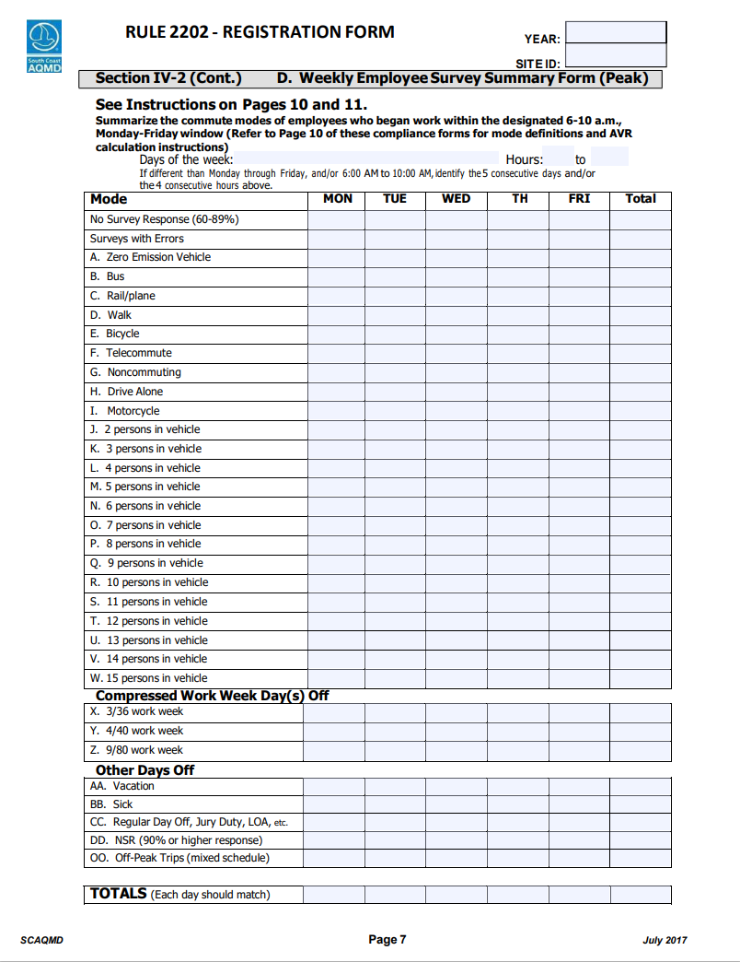
Metrics Associated with Employee Commute Air Quality Impacts
Emissions
Administratively burdensome to calculate for every employee
There are many factors that impact emissions
Mode of travel (e.g., bus, light rail, passenger vehicle, etc.)
Type of vehicle (e.g., zero emission vehicle, internal combustion engine, etc.)
Distance of trip
Congestion
Proxies for employee commute trips
Average Vehicle Ridership (AVR)
Vehicle Miles Travelled (VMT)

Slide 22
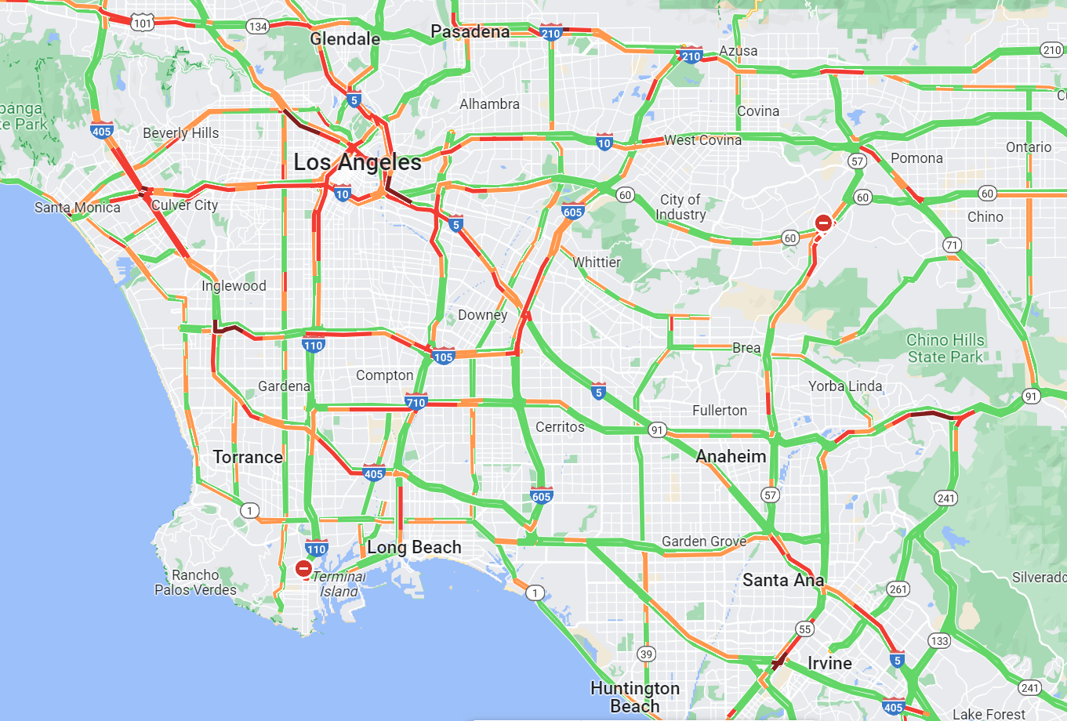
VMT Background:
California Senate Bill 743 (2013)
Prior to July 2020, CEQA required analyzing Level Of Service (LOS) to determine potential traffic-related impacts from projects
LOS evaluated projects on the basis of traffic delay/congestion
Congestion on sections of roads or at intersections is primary consideration rather than distance of trip
Under LOS, mitigation measures were focused on reducing traffic congestion
Starting July 2020, CEQA required analyzing Vehicle Miles Travelled (VMT) to determine potential traffic-related impacts from projects instead of LOS
SB 743 made VMT a key new metric for transportation impacts
Lower VMT also reduces greenhouse gas emissions and traffic-related air pollution
Under SB 743, transportation mitigation measures are now focused on reducing the amount of driving
22

Slide 23
VMT Background :
California Air Resources Board (CARB) &
Southern California Association of Governments (SCAG)
CARB’s State Implementation Plan cites VMT reduction as a control measure to attain federal and state air quality standards
Enhanced transportation options can include walking, biking, transit, rideshare, and other options
Emission reductions from VMT measures needed to supplement other CARB strategies on zero emissions vehicles
CARB’s 2022 Carbon Neutrality Scoping Plan also indicates additional VMT reductions are necessary to reach air quality and climate goals
SCAG’s 2022-2045 Regional Transportation Plan (RTP) uses VMT as a key metric to evaluate performance results of their plan
RTP seeks to reduce both VMT per capita (congestion) as well as emissions per capita (GHGs, and smog-forming pollutants)
RTP showed that the average distance travelled for work trips is >3x the average distance travelled for non-work trips
23

Slide 24
VMT Background:
VMT in Current Rule 2202
Currently, the Rule 2202 AVR Survey asks for employee VMT
VMT is currently not a required field on the employee survey
Potential approach would require VMT to be collected from surveyed employees and reported on the annual compliance submittal
The VMT data collection will guide future rule amendments
24

Slide 25
Proposed Amended Rule 2202
Staff is proposing to amend Rule 2202 in two phases
Phase 2
2025-2026 (rulemaking to begin in 2024)
Phase 1
August 2023
Require VMT reporting to collect data for Phase 2
Consider increase/incentivize telecommuting
Minor rule cleanup and administrative revisions
Consider using VMT as primary metric within rule
Reassess performance zones to factor in new high quality transit areas and travel patterns
Evaluate compliance options for zero emission passenger vehicles and supporting infrastructure
Evaluate continued use of credit options for compliance
Modify rideshare program requirements and reporting

Slide 26
Rule Development Process
Stakeholder Input
Data Analysis and Information Gathering
Draft Proposed Rule Language and Staff Report
Governing Board Committee Review and Public Hearing
Initial Focus and Scope

Slide 27
Rule Amendment Schedule
1st Working Group Meeting
2nd Working Group Meeting
3rd Working Group Meeting
4th Working Group Meeting
Mobile Source Committee
Set Hearing
Public Hearing/ Governing Board
February 23, 2023
March 22, 2023
April 2023
May 2023
May 19, 2023
June 2, 2023
August 4, 2023

Slide 28
Staff Contacts
Rule Development Team
par2202@aqmd.gov
Jeff Inabinet
(909) 396-2453
Natalie Gonzalez
(909) 396-3653
Chelsee Orozco
(909) 396-2641
CEQA
Barbara Radlein
bradlein@aqmd.gov
(909) 396-2716
Proposed Amended Rule 2202 Webpage
http://www.aqmd.gov/home/rules-compliance/rules/scaqmd-rule-book/proposed-rules/rule-2202

